Slide 1


Slide 2
Galen – automation testing framework for visual testing

Slide 3
agenda
Description
How it works
Gspec files
Story file
HTML Reporting
Q&A

Slide 4

Galen Framework - Description
Galen is a powerful automated test framework for testing and validating responsive CSS within your website or web-application
Galen Framework is an open source layout and functional testing framework for websites.
Its written in Java, which allows testing the look and feel of responsive websites.
It has its own special language Galen Specs for describing the positioning and alignment of elements on a Web page.
It is based on Selenium and could be executed via Selenium Web Driver and all the related tools.

Slide 5
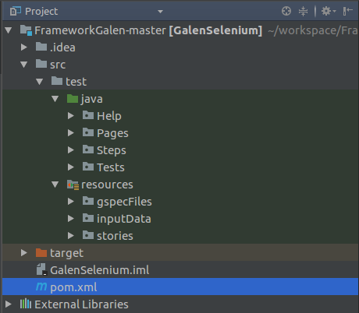
How does it work?
Create a Maven Test Project POM Xml – Dependency
Add Galen Maven Dependency to the pom.xml :
<dependency>
<groupId>com.galenframework</groupId>
<artifactId>galen-java-support</artifactId>
<version>2.4.4</version>
</dependency>
Use selenium Web driver
Galen Framework uses Selenium in order to open web browser and select the tested elements on page.

Slide 6
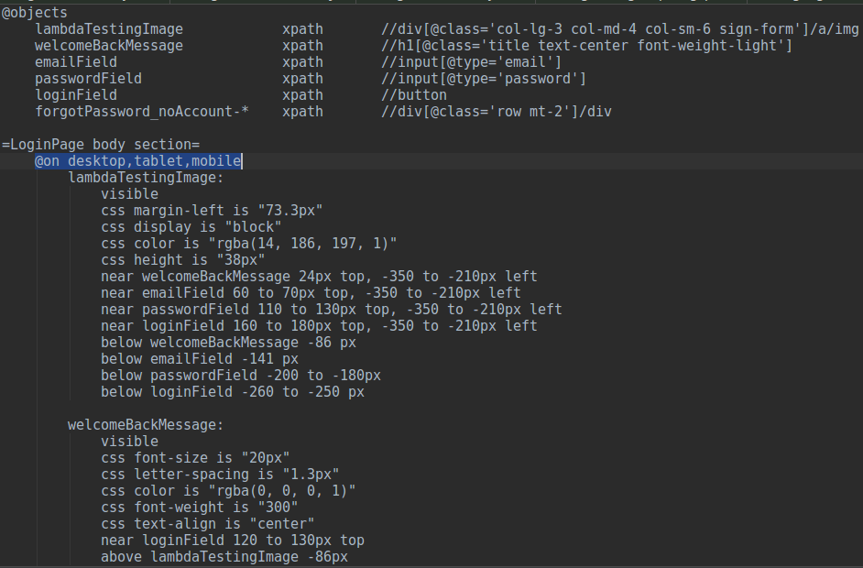
GSPEC FILES
Write a Galen Spec File
It has a special language to describe the layout of web page for different browser sizes
You just need to define your own tags for devices and sizes, and the using the galen spec language write checks for each element on page
The best way to test the layout is to check location and dimensions of elements relatively to each other.
Here is a small example of basic syntax from our project.
text
text
TEXT
text

Slide 7
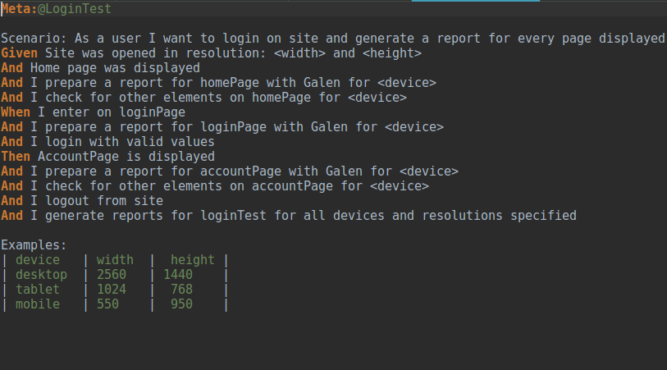
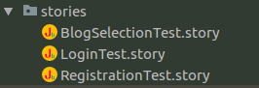
Story files - jbehave
What is a story file
A story is a collection of scenarios, each detailing different examples of the behaviour of a given increment of functionality of the system.
For our project we have three story files:
RegistrationTestStory
LoginTestStory
BlogSelectionStory
text
TEXT
TEXT
text

Slide 8
Story files - Steps
Registration test Story
Login test Story
Blog selection test Story
- Open the URL https://www.lambdatest.com
- The site was opened in three different resolutions : desktop, tablet, mobile.
- Access the Registration page
- Prepare a report for Registration page with Galen for all device
- Create a new account
- Prepare a report for Account page with Galen for all the device
- Logout from site and generate reports for Registration test for all devices.
- Open the URL https://www.lambdatest.com
- The site was opened in three different resolutions : desktop, tablet, mobile.
- Access the Login page
- Prepare a report for Login page with Galen for all device
- Login with valid values
- Prepare a report for Account page with Galen for all the device
- Logout from site and generate reports for Login test for all devices.
Open the URL https://www.lambdatest.com
- The site was opened in three different resolutions : desktop, tablet, mobile.
- Access the Blog list page
- Prepare a report for Blog list page with Galen for all device
- Select a blog from displayed list
- Prepare a report for Blog page with Galen for all the device
- Logout from site and generate reports for Blog selection test for all devices

Slide 9

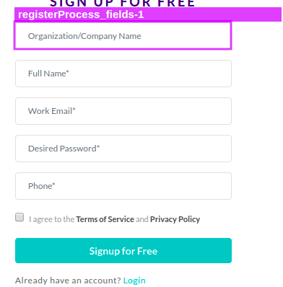
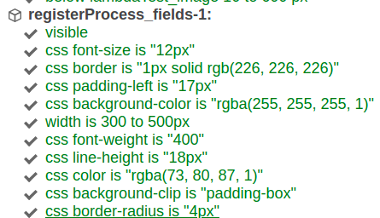
HTML Reporting
Registration test – galen reports for all devices
1 - Successful HTML report will look like this:

Slide 10
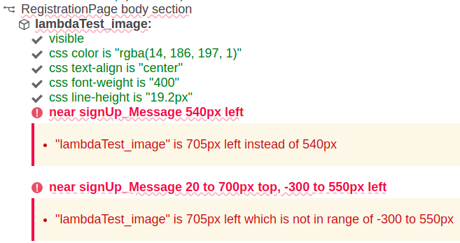
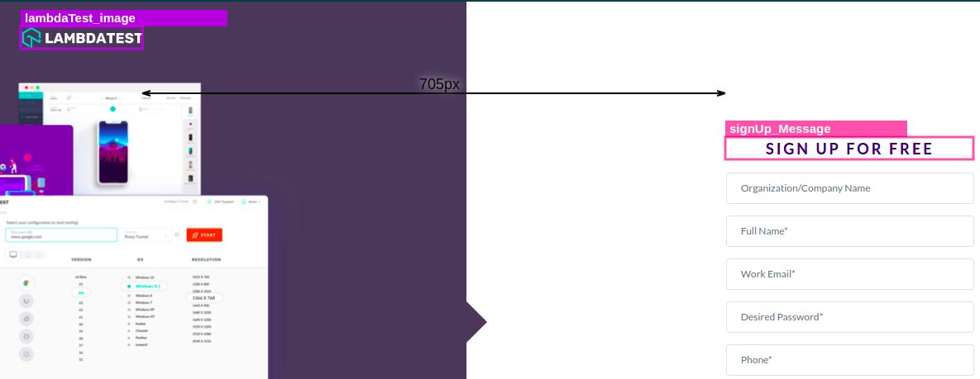
HTML Reporting
registration test – galen reports (layout error)
2 - If there is a layout error, it will highlight it as shown bellow: 3 - Also, when we click the “Showimage comparison” link, it shows the mismatches:

Slide 11

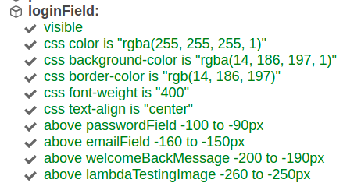
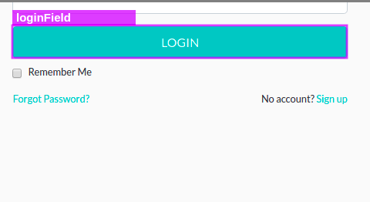
HTML Reporting
Login test – galen reports for all devices
1 - Successful HTML report will look like this:

Slide 12
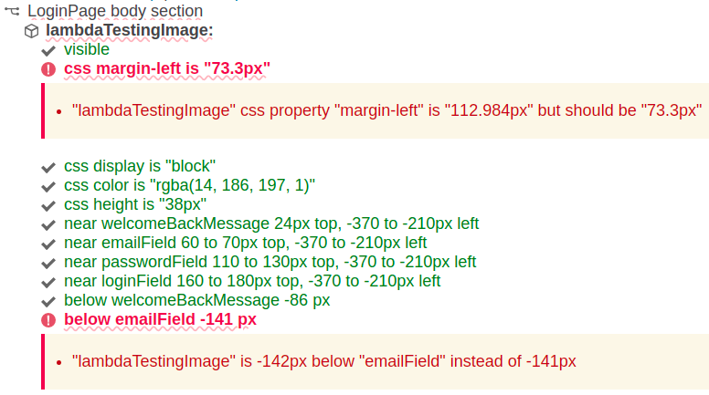
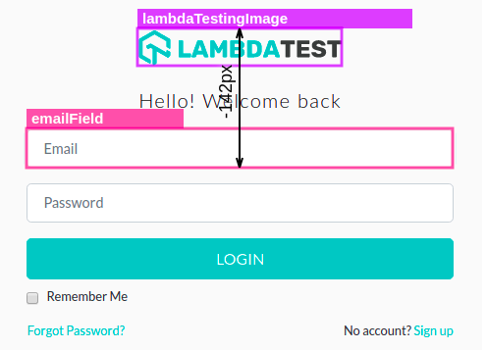
HTML Reporting
Login test – galen reports (layout error)
2 - If there is a layout error, it will highlight it as shown bellow: 3 - Also, when we click the “Showimage comparison” link, it shows the mismatches:

Slide 13

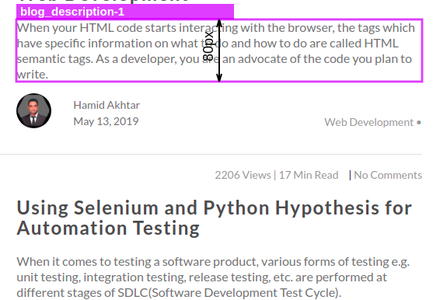
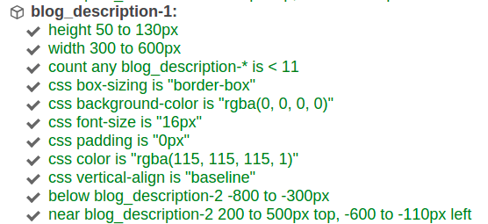
HTML Reporting
Blog selection test – galen reports for all devices
1 - Successful HTML report will look like this:

Slide 14
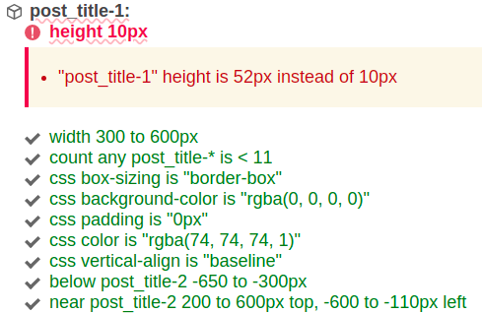
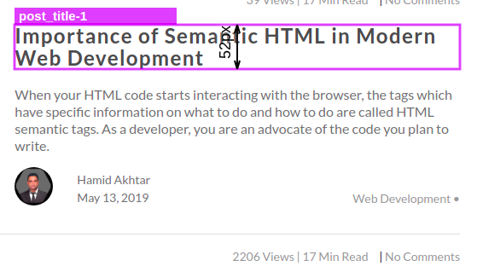
HTML Reporting
Blog selection test – galen reports (layout error)
2 - If there is a layout error, it will highlight it as shown bellow: 3 - Also, when we click the “Showimage comparison” link, it shows the mismatches:

Slide 15
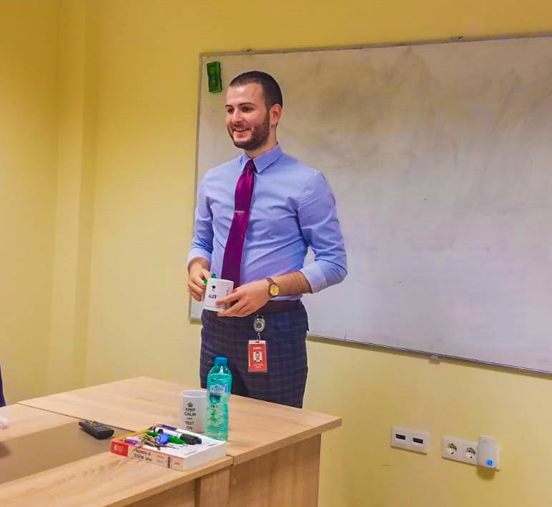

People involved in project
The two guilty in making this amazing, unseen, incredible, fascinating project are.....it was a joke, it's just a simple project.
Alex Dorha – Alex.Dorha@endava.com
Ruben Pintican - Rubint.Pintican@endava.com

Slide 16
Documentation
http://galenframework.com/docs/getting-started-configuration/
https://jbehave.org/introduction.html
https://www.guru99.com/page-object-model-pom-page-factory-in-selenium-ultimate-guide.htmll

Slide 17

Q&A

